Slide 1
Upcoming
30 Apr: HWQ5
1 May: Projects Due NLT 1530
6 May: Block Quiz

Slide 2
Math 152
Lesson | Topic | Reading
35 | Arc Length/Calc w/ Parametrics | 8.1 / 10.2
36 | Polar Coordinates | 10.3
37 | Areas & Lengths in Polar Coords | 10.4
Objectives:
Describe points in two space using polar coordinates
Convert between polar and Cartesian coordinates
Sketch curves or regions in a plane given in polar coordinates
Recognize when polar coordinates are more useful than Cartesian coordinates

Slide 3
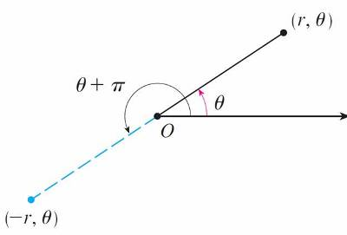
Polar Coordinates
The polar axis is usually drawn horizontally to the right and corresponds to the positive x-axis in Cartesian coordinates.

Slide 4
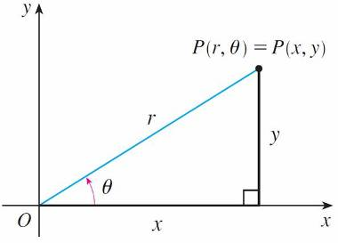
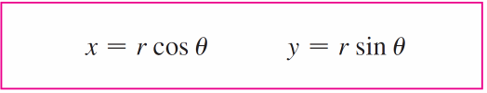
Polar to Cartesian
Relationship between polar and Cartesian coordinates

Slide 5
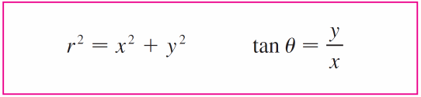
Cartesian to Polar

Slide 6
Polar to Cartesian Eqns
Find the Cartesian representation of:
Get into this form:
and use:

Slide 7
Polar Coordinates
Cartesian coordinates unique, while polar coordinates have many representations.
For instance: (1, 5π /4) = (1, –3π /4) = (1, 13π /4) = (–1, π /4)

Slide 8
Applications of Polar Coords
Inertial Nav
Spacecraft orbits
Electronic Warfare (jamming, etc)
Antenna Transmission Patterns
Radar
Comm Antenna Tracking

Slide 9
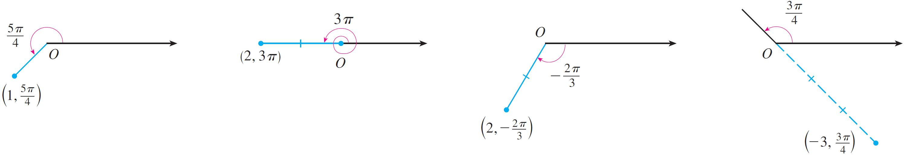
Example
Plot the points whose polar coordinates are given.
(a) (1, 5π /4) (b) (2, 3π ) (c) (2, –2π /3) (d) (–3, 3π /4)
Solution:
Figure 3

Slide 10
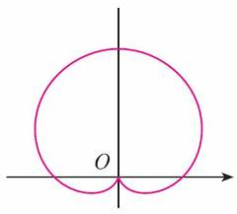
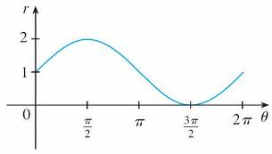
Example
Sketch the curve r = 1 + sin θ.
Solution:
r = 1 + sin θ, 0 ≤ θ ≤ 2π
Polar form captures the entire curve

Slide 11
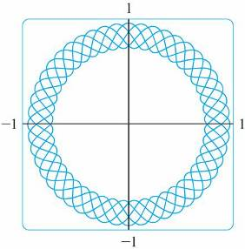
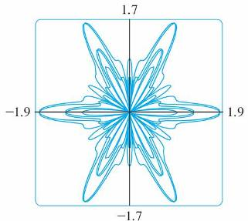
Graphing Polar Curves with Graphing Devices
we need to convert to parametric equations first.
polar equation r = f (θ ) and write its parametric equations as
x = r cos θ = f (θ ) cos θ y = r sin θ = f (θ ) sin θ
r = sin²(2.4θ ) + cos⁴(2.4θ )
r = sin²(1.2θ ) + cos³(6θ )

Slide 12
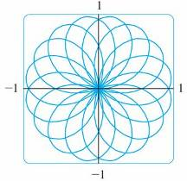
Example
Graph the curve r = sin(8θ / 5).
Solution: the corresponding parametric equations, which are
x = r cos θ = sin(8θ / 5) cos θ y = r sin θ = sin(8θ / 5) sin θ

Slide 13
Desk Work
Find the Cartesian Eqn:

Slide 14
Solutions

Slide 15
backups

Slide 16
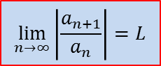
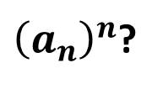
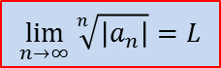
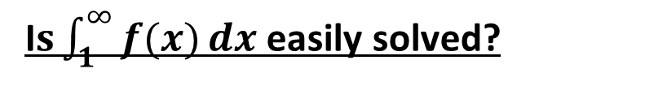
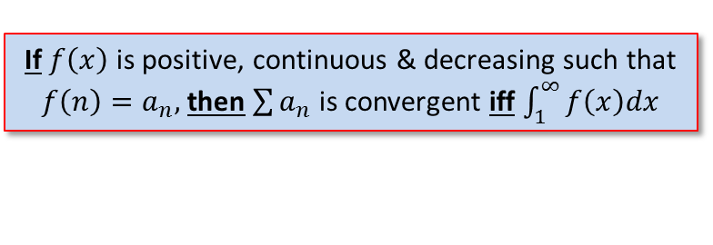
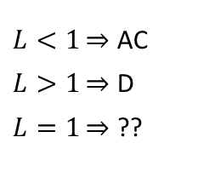
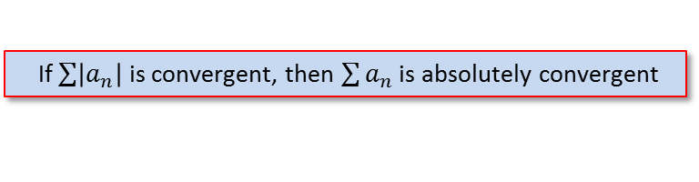
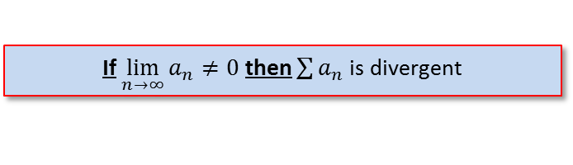
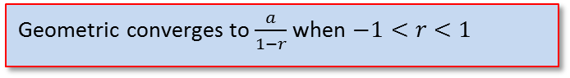

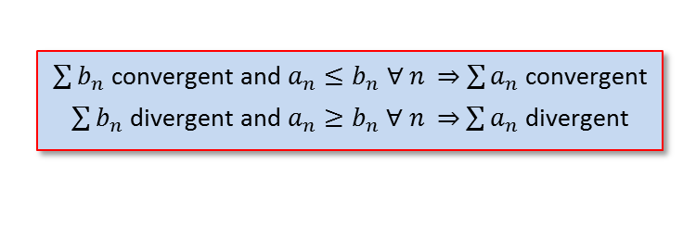
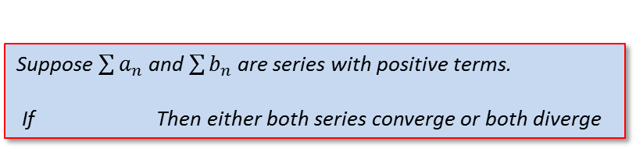
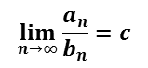
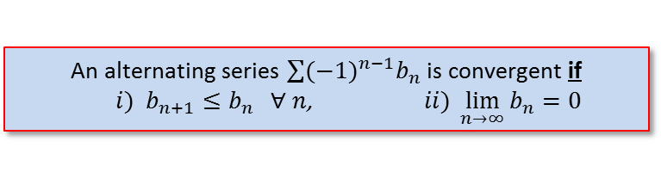
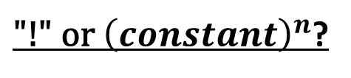
Strategy for Testing Series
Test for Divergence
If $\lim_{n→∞}{a_{n}≠0}$ then $\sum{a_{n}}$ is divergent
g-series?
Geometric converges to $\frac{a}{1−r}$ when $−1<r<1$
p-series?
$p$-series converges when $p>1$
“like” a geo- or p-series?
Comparison Test
$\sum{b_{n}}$ convergent and $a_{n}≤b_{n}$ $∀$ $n$ $\sum{a_{n}}$ convergent
$\sum{b_{n}}$ divergent and $a_{n}≥b_{n}$ $∀$ $n$ $\sum{a_{n}}$ divergent
Limit Comparison Test
Suppose $\sum{a_{n}}$ and $\sum{b_{n}}$ are series with positive terms.
If Then either both series converge or both diverge
$$\lim_{n→∞}{\frac{a_{n}}{b_{n}}}=c$$
c is a finite number & c > 0
Alternating Series?
An alternating series $\sum{{(−1)}^{n−1}b_{n}}$ is convergent if
$i) b_{n+1}≤b_{n} ∀ n$, $ii) \lim_{n→∞}{b_{n}=0}$
If $\sum{\left|a_{n}\right|}$ is convergent, then $\sum{a_{n}}$ is absolutely convergent
$L<1\overset{⇒}{}$ AC
$L>1\overset{⇒}{}$ D
$L=1\overset{⇒}{}$ ??
${\text{"!" }\text{or} \left(constant\right)}^{n}$?
$$\lim_{n→∞}\left|\frac{a_{n+1}}{a_{n}}\right|=L$$
${\left(a_{n}\right)}^{n}$?
$$\lim_{n→∞}{\sqrt[n]{\left|a_{n}\right|}}=L$$
I$s\int_{1}^{∞}{f(x)}dx$ easily solved?
If $f\left(x\right)$ is positive, continuous & decreasing such that $f\left(n\right)=a_{n},$then$\sum{a_{n}}$ is convergent iff $\int_{1}^{∞}{f\left(x\right)dx}$
Notes:
Section 11.7, p739
Comparison test: if the term is a rational function or an algebraic function of n (involving roots of polynomials), then the series should be compared with a p-series, keeping only the highest powers of n in the numerator & denominator
Ratio & Root test: inconclusive if L = 1, or DNE

